Slide 1

SEIU ONLINE LEARNING PROJECT ROADMAP
July 22, 2014

Slide 2
Purpose
Local unions need a:
Well-organized, accessible site to find education training curriculum from multiple sources, not siloed.
Place to post and share curriculum with each other.
Place for more local union members to get trained without having to receive in-person training.
Notes:
Without having to receive in-person training.

Slide 3
Outcome
Well-organized, accessible site with materials from sources union wide.
Usage rates go up significantly.
Site awareness increases significantly.
More people receive training.
High rate of posting and sharing.
People at locals benefit from sharing successes and curriculum.
Notes:
Without having to receive in-person training.

Slide 4
Process
A strategic and tactical approach to creating a new online learning platform:
Research best practices, organizational goals, user requirements
Reorganize content
Determine ways to create online communities
Redesign site or build new site
Invest in resources
Bring in other departments to use the site

Slide 5
Research
The recommendations in this roadmap are informed by our research to date, which included:
Reviewing current sites, content, curriculum materials.
Talking to users, stakeholders, and other organizations with similar goals and sites.
Looking at other sites with online learning and knowledge sharing tools.

Slide 6
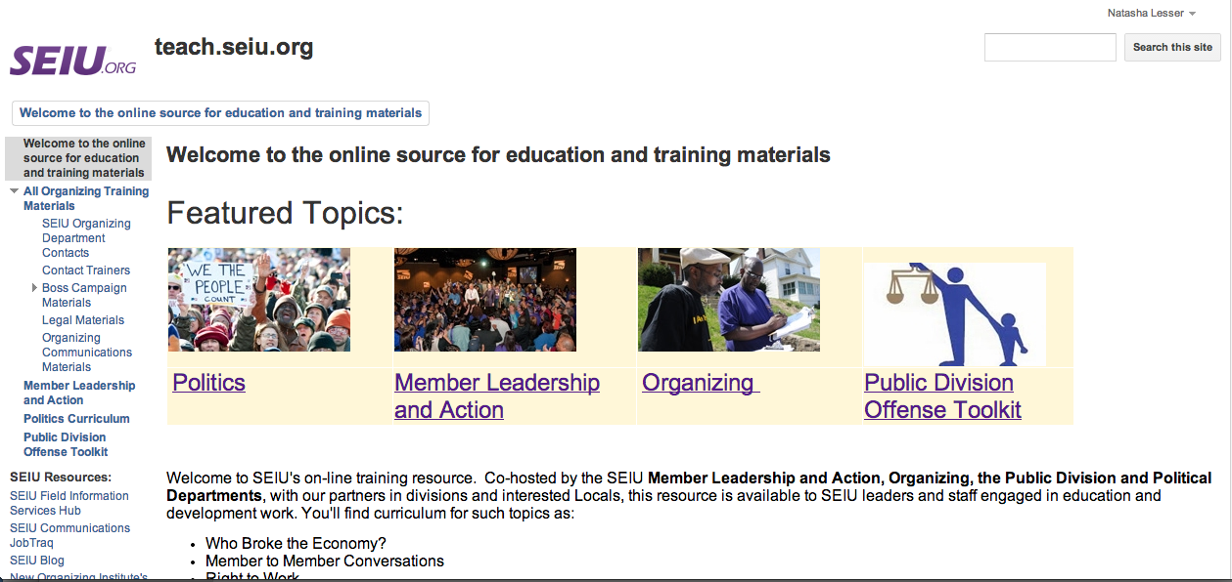
Research Findings: Teach.seiu.org

Slide 7
Research Findings:
Teach.seiu.org
Difficulties with Teach.seiu.org:
  Accessing site, even with permission and right type of email.
  Limited design options.
  Materials organization is not user friendly, difficult to find things.
  Not updated regularly.
  Users get frustrated using the site and instead contact International or internal network and ask where to find information.
Notes:
Teach is built with Google sites.
Users get overwhelmed and don’t have the time to spend the time searching for materials: Instead they contact the International or their internal network to ask where to find specific materials.
- Technical issues: people have trouble accessing the site even when they have permission and the correct type of email address.

Slide 8
Research Findings:
Teach.seiu.org
Difficulties with Teach.seiu.org:
  Materials on Teach are siloed by department, by curriculum, by event – making it hard for people to find content, unless they know where it lives.
  Users want to find individual materials to use as well as entire curriculum packages.
  Needs to be better communication about Teach as a resource.

Slide 9
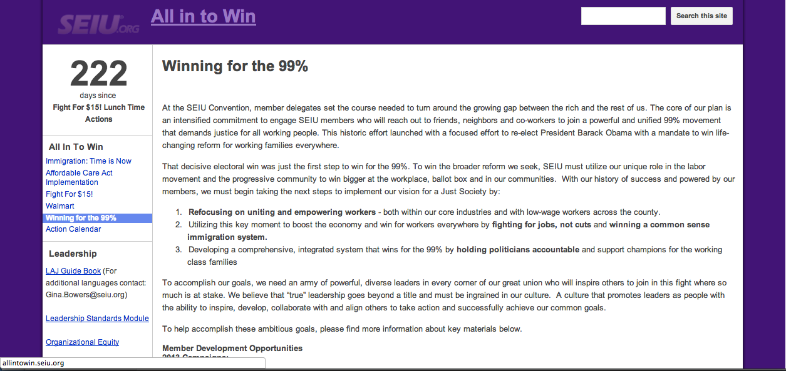
Research Findings:
Allintowin.seiu.org
Notes:
- Allintowin is also built with Google sites
- Allintowin is used more than Teach because no login is required and materials are more clearly organized (around specific campaigns)
- Materials could also be better organized and easier to find on Allintowin

Slide 10
Research Findings: Allintowin.seiu.org
Allintowin is also built with Google sites.
Allintowin is used more than Teach because no login is required and materials are more clearly organized (around specific campaigns).
Materials could also be better organized and easier to find on Allintowin.

Slide 11
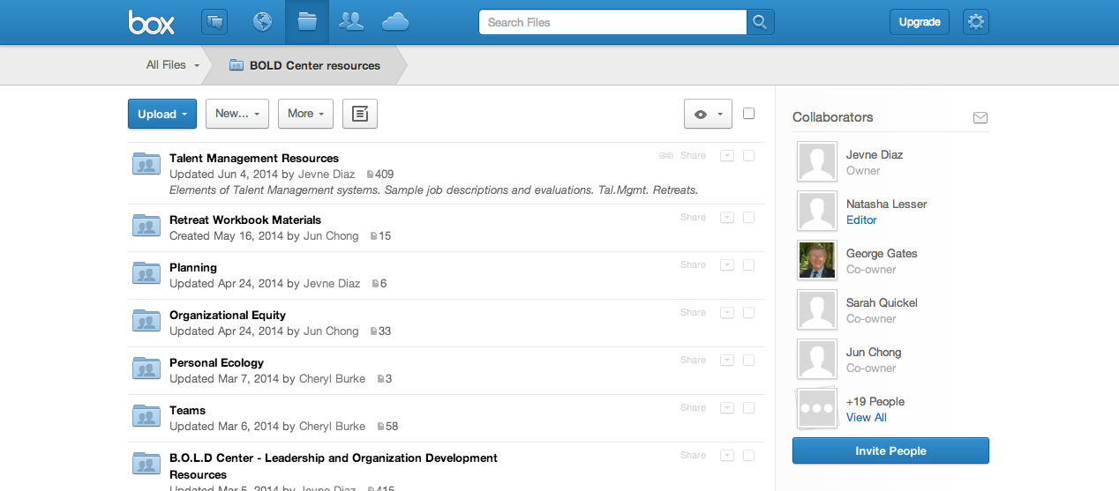
Research Findings:
BOLD Site

Slide 12
Research Findings:
BOLD Site
BOLD uses Box.com, a document and file sharing platform with limited “seats.”
BOLD’s site requires permission from site manager for access and log in.
Not many people know about the BOLD site, though faculty and coaches are enthusiastic about the idea of a place to find and share resources.
Notes:
“Seats” means the number of people who can use the site at any one time -- more seats would need to be purchased if more users were added.
BOLD uses Box.com, a document and file sharing platform with limited “seats”
BOLD’s site requires permission from site manager for access and log in
Not many people know about the BOLD site, though faculty and coaches are enthusiastic about the idea of a place to find and share resources

Slide 13
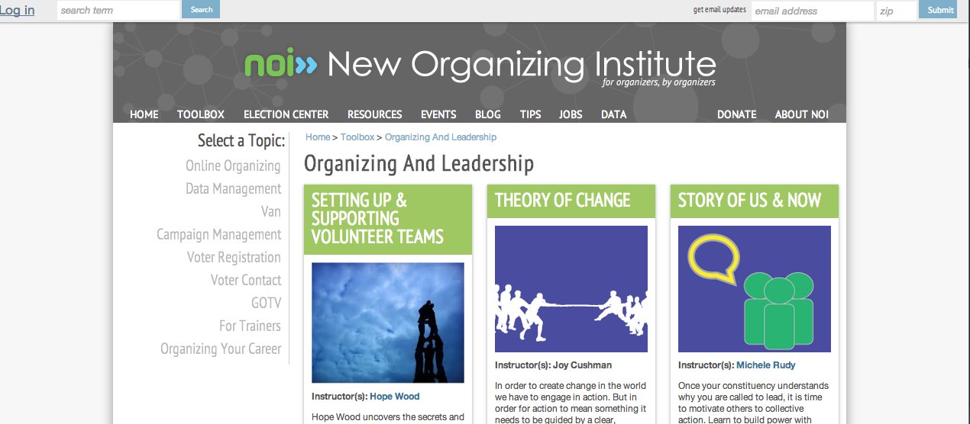
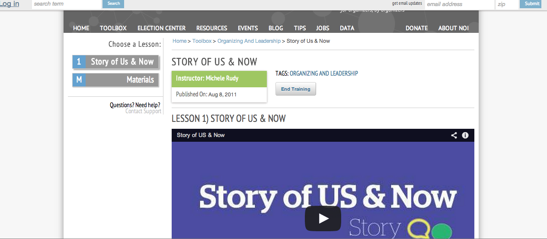
Research Findings:
NOI Toolbox
Notes:
The NOI Toolbox on the NOI site offers a very good organizational model.
- A good example of online training with use of overview video and links
to materials plus comprehensive tagging.

Slide 14
Research Findings:
NOI Toolbox
The NOI Toolbox offers a very good organizational model for online curriculum materials.
Content is packaged with video, narrated PowerPoint, or introductory copy, which provides context to curriculum materials.
Comprehensive tagging allows for content to be available in multiple categories.
Notes:
The NOI Toolbox on the NOI site offers a very good organizational model.

Slide 15
Research Findings:
NOI Toolbox
Resources at NOI dedicated to developing online learning materials.
NOI’s Online Training Manager and her team maintain the site and work closely with trainers to develop new online curriculum.
Developing online components for training is built 25% into the training teams’ time.

Slide 16

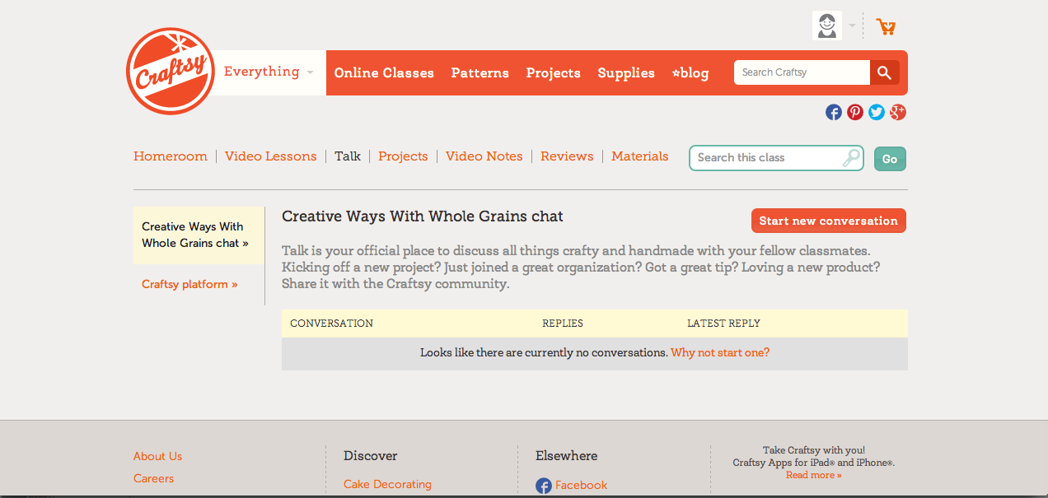
Research Findings:
Online Learning Platforms
Notes:
Adobe Education Exchange and Craftsy are good examples of online learning platforms in other spaces
Adobe site has comprehensive, well-designed sections for resources, discussions, and online training
Craftsy provides a good example of easy-to-use online classes with related discussion areas

Slide 17
Research Findings:
Online Learning Platforms
Adobe Education Exchange and Craftsy are good examples of online learning platforms in other spaces.
Adobe site has comprehensive, well-designed sections for resources, discussions, and online training.
Craftsy provides a good example of easy-to-use online classes with related discussion areas.
Notes:
- Adobe Education Exchange and Craftsy are two other good examples of online learning platforms from different spaces.

Slide 18
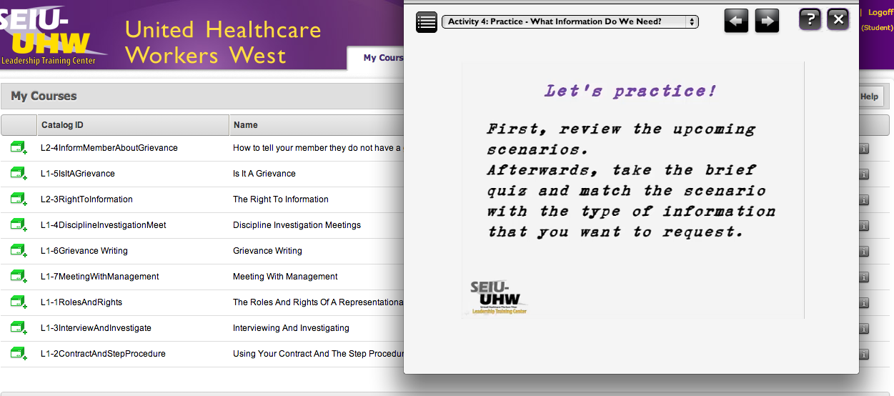
Research Findings:
Learning Management
Systems (LMS)
Notes:
Many LMS platforms to choose from, with varying capabilities, costs
Interest within SEIU for LMS-type online courses and training, but not yet much demand
UHW West and SEIU Local 1000 are already using LMS as another modality for Stewardship training

Slide 19
Research Findings:
Learning Management
Systems (LMS)
Many LMS platforms to choose from, with varying capabilities, costs.
Interest within SEIU for LMS-type online courses and training, but not yet much demand.
UHW West and SEIU Local 1000 are already using LMS as another modality for Stewardship training.
Notes:
A learning management system (LMS) is a software application for the administration, documentation, tracking, reporting and delivery of e-learning education courses or training programs.
Learning Management Systems generally have a way to measure progress and provide certification.
UHW West is using the Trivantis/Lectora LMS platform for Stewardship certification. We spoke with Ramon Lazo, the eLearning specialist at UHW West, who said that they are happy with how it works, the cost, and the customer service support.
SEIU Local 1000 is using the Skillsoft platform.
When/if SEIU adopts an LMS, would need to do more extensive research to define capabilities required and offered and to look into costs and support offered by various LMS platforms.

Slide 20
Research Findings:
Learning Management
Systems (LMS)
Not many people are taking UHW West online courses yet because no outreach and no internet access for many.
UHW West has resources dedicated to creating online courses.
LMS platform would require initial investment and dedicated resources.
Possible to partner with one of locals.
Notes:
UHW West is using the Trivantis/Lectora LMS platform for Stewardship certification. We spoke with Ramon Lazo, the eLearning specialist at UHW West, who said that they are happy with how it works, the cost, and the customer service support.
The LMS provides a way to access training without regards to distance, so that local members who far away from a place where training is can still get training.
Internet access is an issue for many of the locals – members don’t have it. Other options that UHW West has explored have included group online training, so that the courses are offered in one location for many people to participate or the training modules are put on CD Rom.

Slide 21
Recommendations:
Build a New Site
Create a new site with reorganized, consolidated, updated, contextualized content along lines of the NOI model.
Add a more formal Learning Management System (LMS) to allow for tracking and certification for online courses, as needed.
Explore options and phases in handout.

Slide 22
Recommendations:
Reorganize Content
Organize content according to a user-centered approach rather than organizational structure, making it easier to find content in multiple categories.
Package content along lines of the “NOI Model”: introductory copy, video, or narrated PowerPoint provides context to materials.
Combine LAJ and BOLD sites to make all resources available in one place.

Slide 23
Recommendations:
Reorganize Content
Toolbox: Training and educational materials in a variety of formats (Word, PDF, PPTs, videos, etc.).
BOLD Center: Information about BOLD leadership development programs and educational and training materials.
Upcoming Trainings: List of upcoming trainings, retreats, conferences - could change to Online Training when available.
Notes:
In order to better organize the resources and make them easier to find, we recommend organizing content on the site into the following categories.

Slide 24
Recommendations:
Reorganize Content
Learning Communities: Discussions, forums, other online communities of practice.
About: Links to LAJ Guidebook, Leadership Standards, and contact info for departments and other relevant staff.

Slide 25
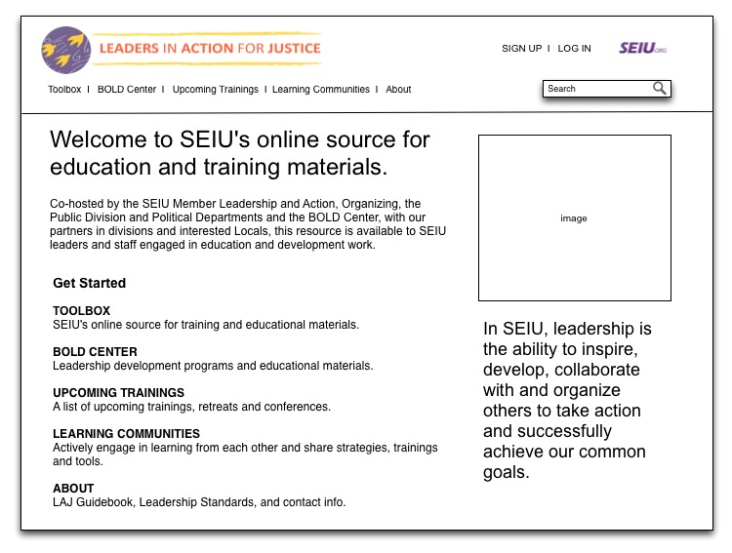
Recommendations:
Site Architecture
Site content
organization
Notes:
HANDOUT PAGES.
This wireframe of the homepage of the Online Learning Platform illustrates an initial recommended architecture for the site.
Toolbox: Training and educational materials in a variety of formats (Word Docs, PDF, PPTs, videos, etc.)
BOLD Center: Information about BOLD leadership development programs and get access to educational and training materials.
Upcoming Trainings – Users would find a list of upcoming trainings, retreats and conferences and eventually online training listings, when available. This navigation could be changed to Online Training when this becomes available.
Learning Communities – Users would be able to engage in discussions, forums and other communities of practice.
About – Users would find links to the LAJ Guidebook, Leadership Standards, and contact info for education, BOLD, and other relevant staff.
Search bar – Allows users to search all content on the site.
Sign Up/Log In – For user account sign up and log in, if a user account is required.
LAJ logo – links back to homepage of LAJ site.
SEIU logo – links to main SEIU site.

Slide 26
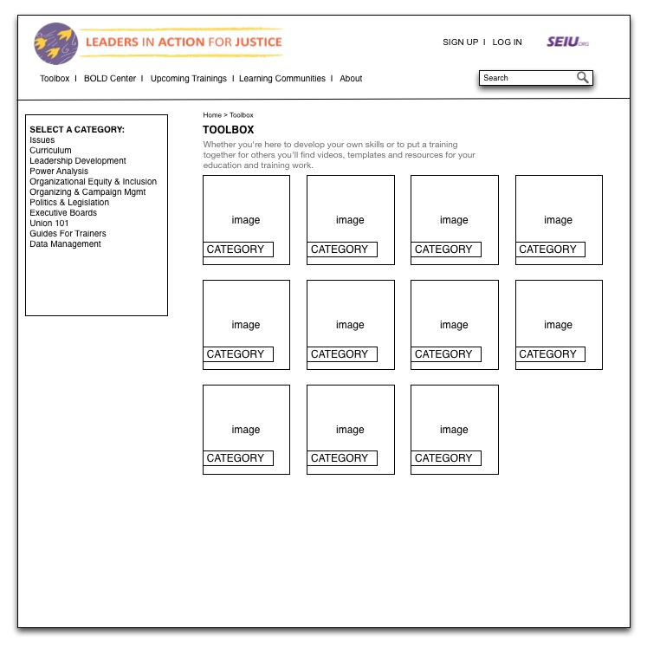
Recommendations:
Site Architecture
Notes:
- This wireframe illustrates the navigational structure of the Toolbox section of the site. Refer to the HANDOUT for more details.
- Clicking on the images links users to the page about that particular category.

Slide 27
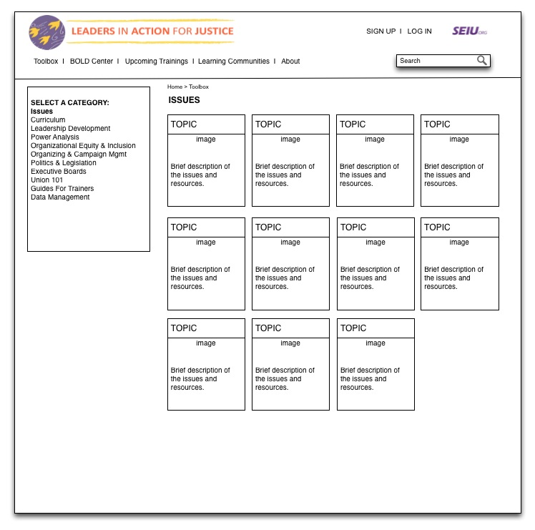
Recommendations:
Site Architecture
Notes:
This wireframe illustrates the navigational structure of the Issues section of Toolbox (see Handout for more details).

Slide 28
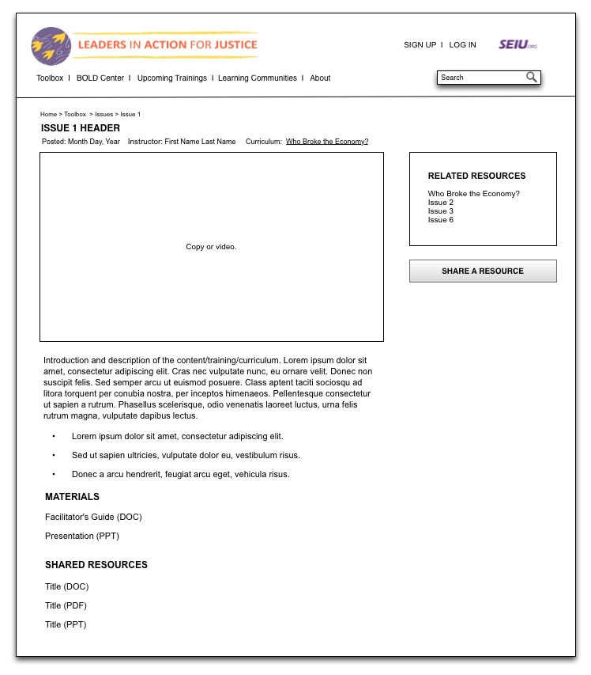
Recommendations:
Site Architecture
Notes:
This wireframe illustrates how a page of content in the Toolbox section could be structured.
Note that the content on this page could be copy or video or a narrated PPT, with links to related materials. All of the template designs proposed here are flexible to allow for various types of content to be used, depending upon what’s available.
The Related Resources module on the right provides a tool for linking to the larger curriculum and to other related links.
The Share a Resource button allows users to upload materials to share.

Slide 29
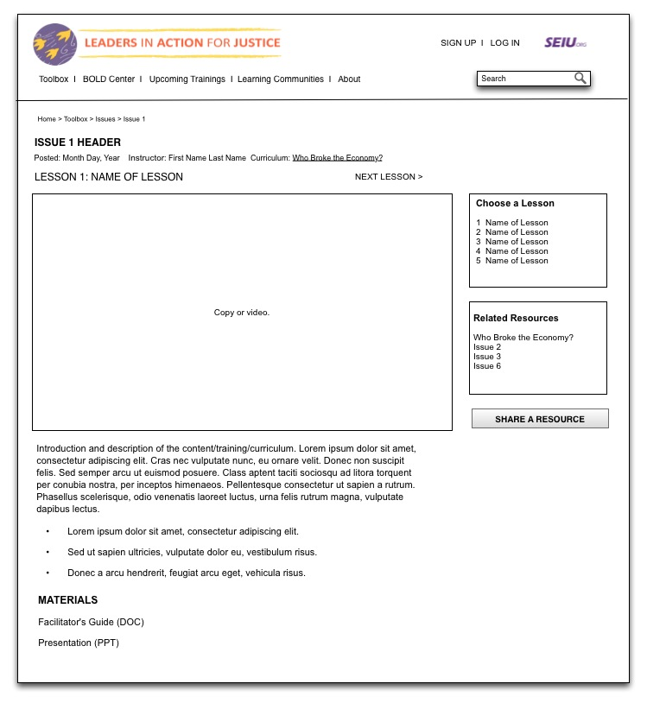
Recommendations:
Site Architecture
Notes:
This wireframe illustrates how a lesson with multiple sections could be structured.
Note that the content on this page could be copy or video or a narrated PPT, with links to related materials. The template is flexible to allow for various types of content to be used, depending upon what’s available.
The Choose a Lesson module on the right links users to other lessons in the series.
The Related Resources module on the right provides a tool for linking to the larger curriculum and to other related links.
The Share a Resource button allows users to upload materials to share.

Slide 30
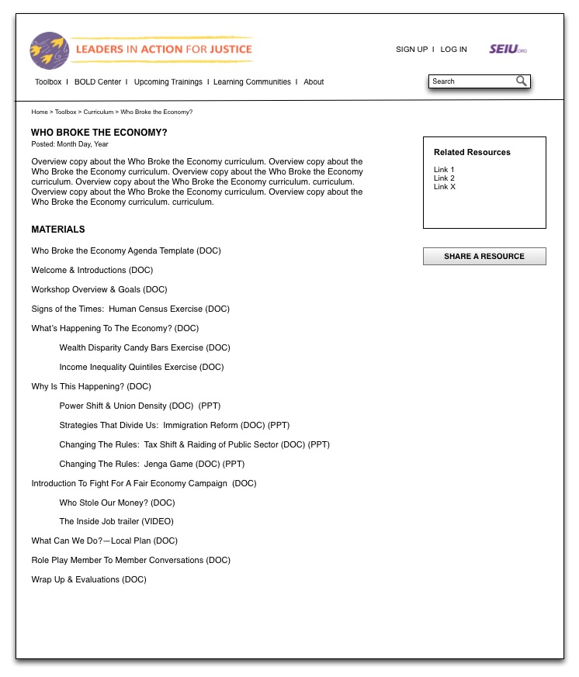
Recommendations:
Site Architecture
Notes:
This wireframe illustrates one option of how the materials for an entire curriculum could be structured in the Toolbox section.
This option has introductory copy plus links to all of the materials in a given curriculum.

Slide 31
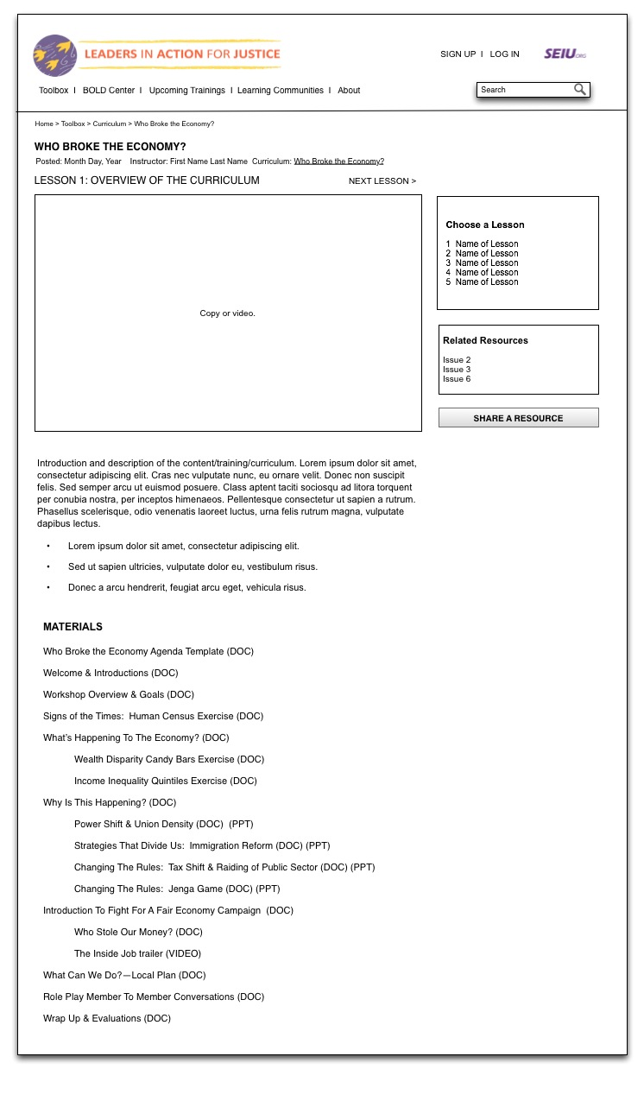
Recommendations:
Site Architecture
Notes:
This wireframe illustrates another option of how the materials for an entire curriculum could be structured in the Toolbox section.
This option is structured like a training module with video and links to other lessons in the curriculum.

Slide 32
Recommendations:
Online Courses
Do we introduce an LMS?
Interest within SEIU for comprehensive online courses where progress is measured and reported on, but not yet much demand.
Introduce a more formal LMS that would allow for measured progress and certification as demand grows.
Notes:
It’s possible to come to up with ways to assess the training modules without implementing a full LMS.
Some ways of doing this, include:

Slide 33
Recommendations:
Online Courses
In the meantime:
Continue to research best LMS options for SEIU, possible partnerships.
Begin with the “NOI Model.”
Explore other forms of measurement, including follow-up questions via email, commenting capabilities, tracking of videos watched and documents downloaded.

Slide 34
Recommendations:
Learning Communities
Promoting involvement in online learning communities could take multiple forms, depending upon the context.
For instance, online discussions, Facebook groups, or Google Hangouts for attendees of conferences, training sessions or retreats - to introduce the group before sessions, follow up on lessons learned, or continue working together online after or in between sessions.

Slide 35
Recommendations:
Learning Communities
Encourage discussion around online curriculum materials with follow-up questions, commenting capabilities.
Use Twitter hashtags (e.g., #1U, #memberpower) at conferences and other events to promote online dialogue.
Get people to blog on timely topics related to a specific curriculum or issue.
Send out emails promoting new resources and topics on the online learning platform.

Slide 36
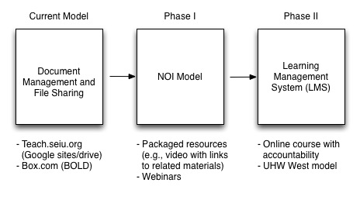
Roadmap

Slide 37
Recommendations:
Project Approach
There are a number of ways to approach the development of the online learning platform. Each of the options has pros and cons – these are spelled out in the handout, “SEIU Online Learning Platform Project Options.”
Notes:
HANDOUT. These are spelled out in the Options chart – walk through it.

Slide 38
Recommendations:
Online Learning Team
A crucial factor in the success of the online learning platform is ensuring that we have the right resources to help us achieve our goals, no matter which option we go with.
Ideally, at least one person would be dedicated to creating content and managing and maintaining the online learning platform.

Slide 39
Recommendations:
Online Learning Team
The LMS would require dedicated resources as well.
Content and training materials could be created in house and/or by consultants.
Technical support would be needed to maintain the online learning platform and create new functionality as needed.
Notes:
Responsibilities for this person:
Work closely with education and training staff to translate training resources and curriculum content into a format that works best for the online learning platform.
Create new training materials/modules for the online platform.
Videotape training presentations, conferences.
Create voiceover PPTs and other videos.
Edit videos for online use.
Add content to the site.
Tag site content, maintain metadata.
Teach training and curriculum development/education staff how to create and edit videos, etc.
Facilitate online communities of practice.
Run webinars.
Ask managers, organizers and education and training staff at locals for resources that they’ve created and are using and upload those materials to share on the site.
Archive content.
Create and manage email and other communications to keep people updated about new contents on the site.

Slide 40
Resources:
Partnerships
Explore the possibility of partnering with other organizations to create online materials or use their platforms.
Some possibilities:
  Midwest Academy for online training content
  NOI for online training content or even platform
  BOLD faculty and coaches
  UHW West or Sacramento 1000 for LMS

Slide 41
Site Access
Need to determine whether the online learning platform will be open and accessible for anyone to view or whether users need to create an account to view the site and accessible only to SEIU.

Slide 42
Site Access: Options
Allow anyone access to the site.
Allow anyone to access the site, but require all users to create an account.
Only allow SEIU employees/members/consultants to create an account and access the site.
Question is whether it’s okay or not for anyone to have access to SEIU materials.

Slide 43
Next Steps
Decide what platform technology works best for our needs from the options presented.
Cost out acquiring and maintaining the platform.
Senior team decides whether or not to make the financial and staff investment.
Continue to explore possible shared resources and partnerships.
Establish a committee with local union staff to provide guidance and feedback.
Select audiences and content to start developing as prototypes.

